Slide 1

Everything you need to know about Azure Stack HCI 23h2 in 20 minutes
Everything you need to know about Azure Stack HCI 23h2 in 30 minutes
Jan-Tore Pedersen
Principal Consultant
Spirhed AS Norway
Level: Intermediate

Slide 2

Session Survey
Your feedback is very important to us
Please take a moment to complete the session survey found in the mobile app
Use the QR code or search for “Converge360 Events” in your app store
Find this session on the Agenda tab
Click “Session Evaluation”
Thank you!

Slide 3
Azure Stack HCI 23h2 Feature Overview

Slide 4
23h2 features
Simpler, repeatable deployment
Update management
VM extensions including Microsoft Defender for Cloud
New Site manager construct in Azure Arc to help organize resources
Improvements to core stack and hypervisor
Stronger security posture
Support for Azure Virtual Desktop for Azure Stack HCI production workload

Slide 5
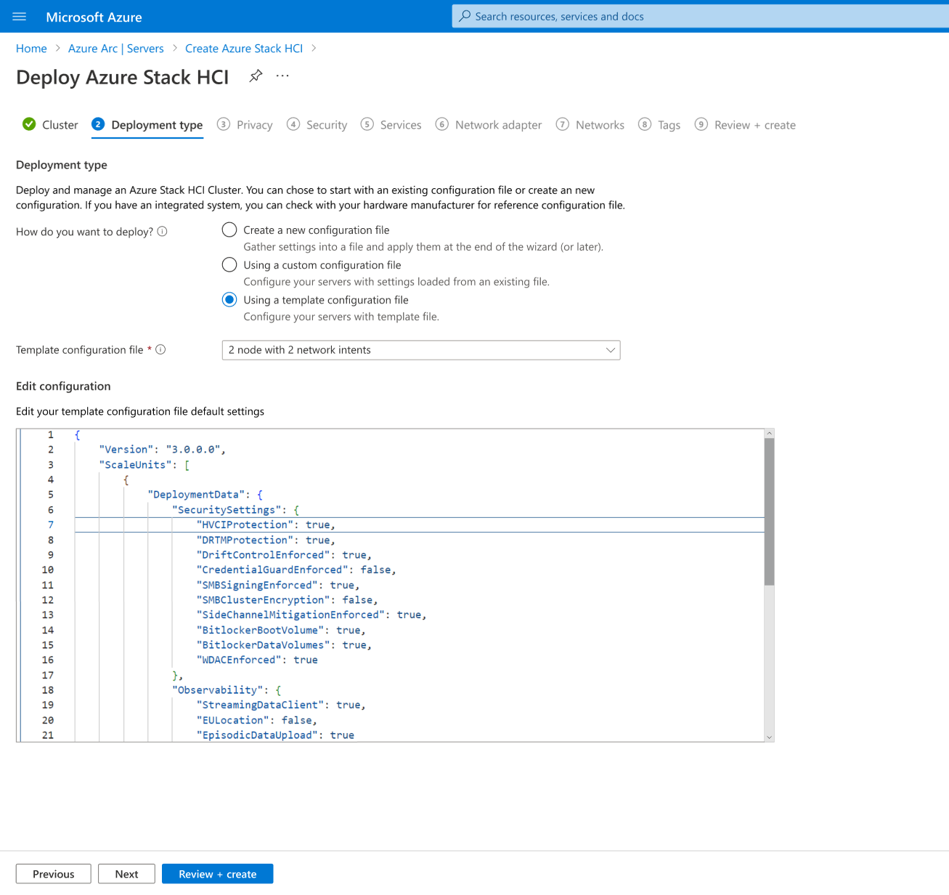
23h2 feature 1 of 7
Simplified cluster deployment, with new Lifecycle Manager feature
Azure Arc (Resource Bridge) set up automatically for provisioning VMs
Templatize clusters in ARM and deploy onto minimally-configured servers
Azure Arc (Resource Bridge) set up for provisioning Kubernetes clusters

Slide 6
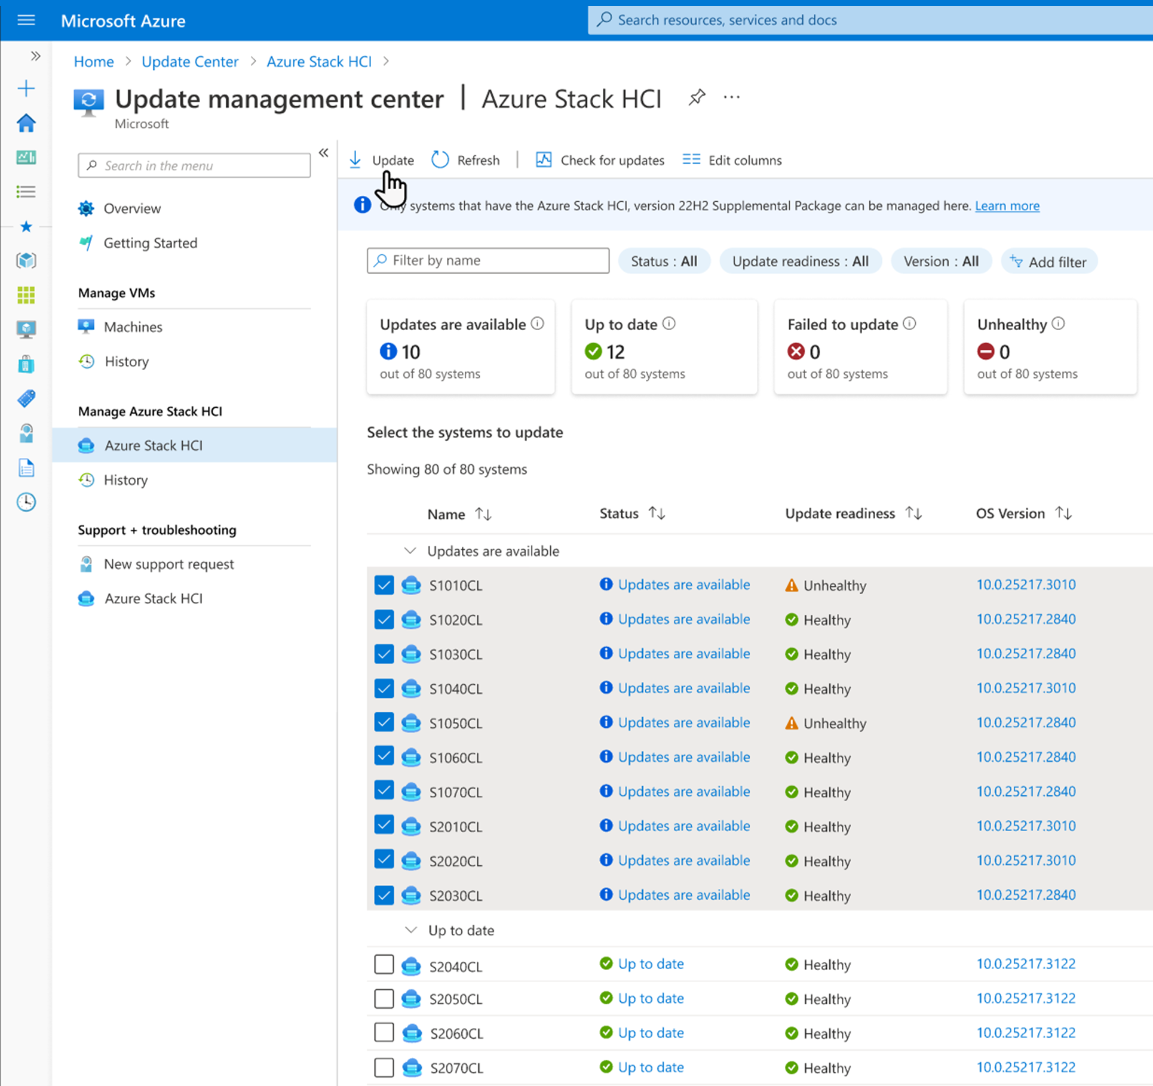
23h2 feature 2 of 7
Manage updates for Azure Stack HCI clusters from the Azure portal, including at-scale (~100s)

Slide 7
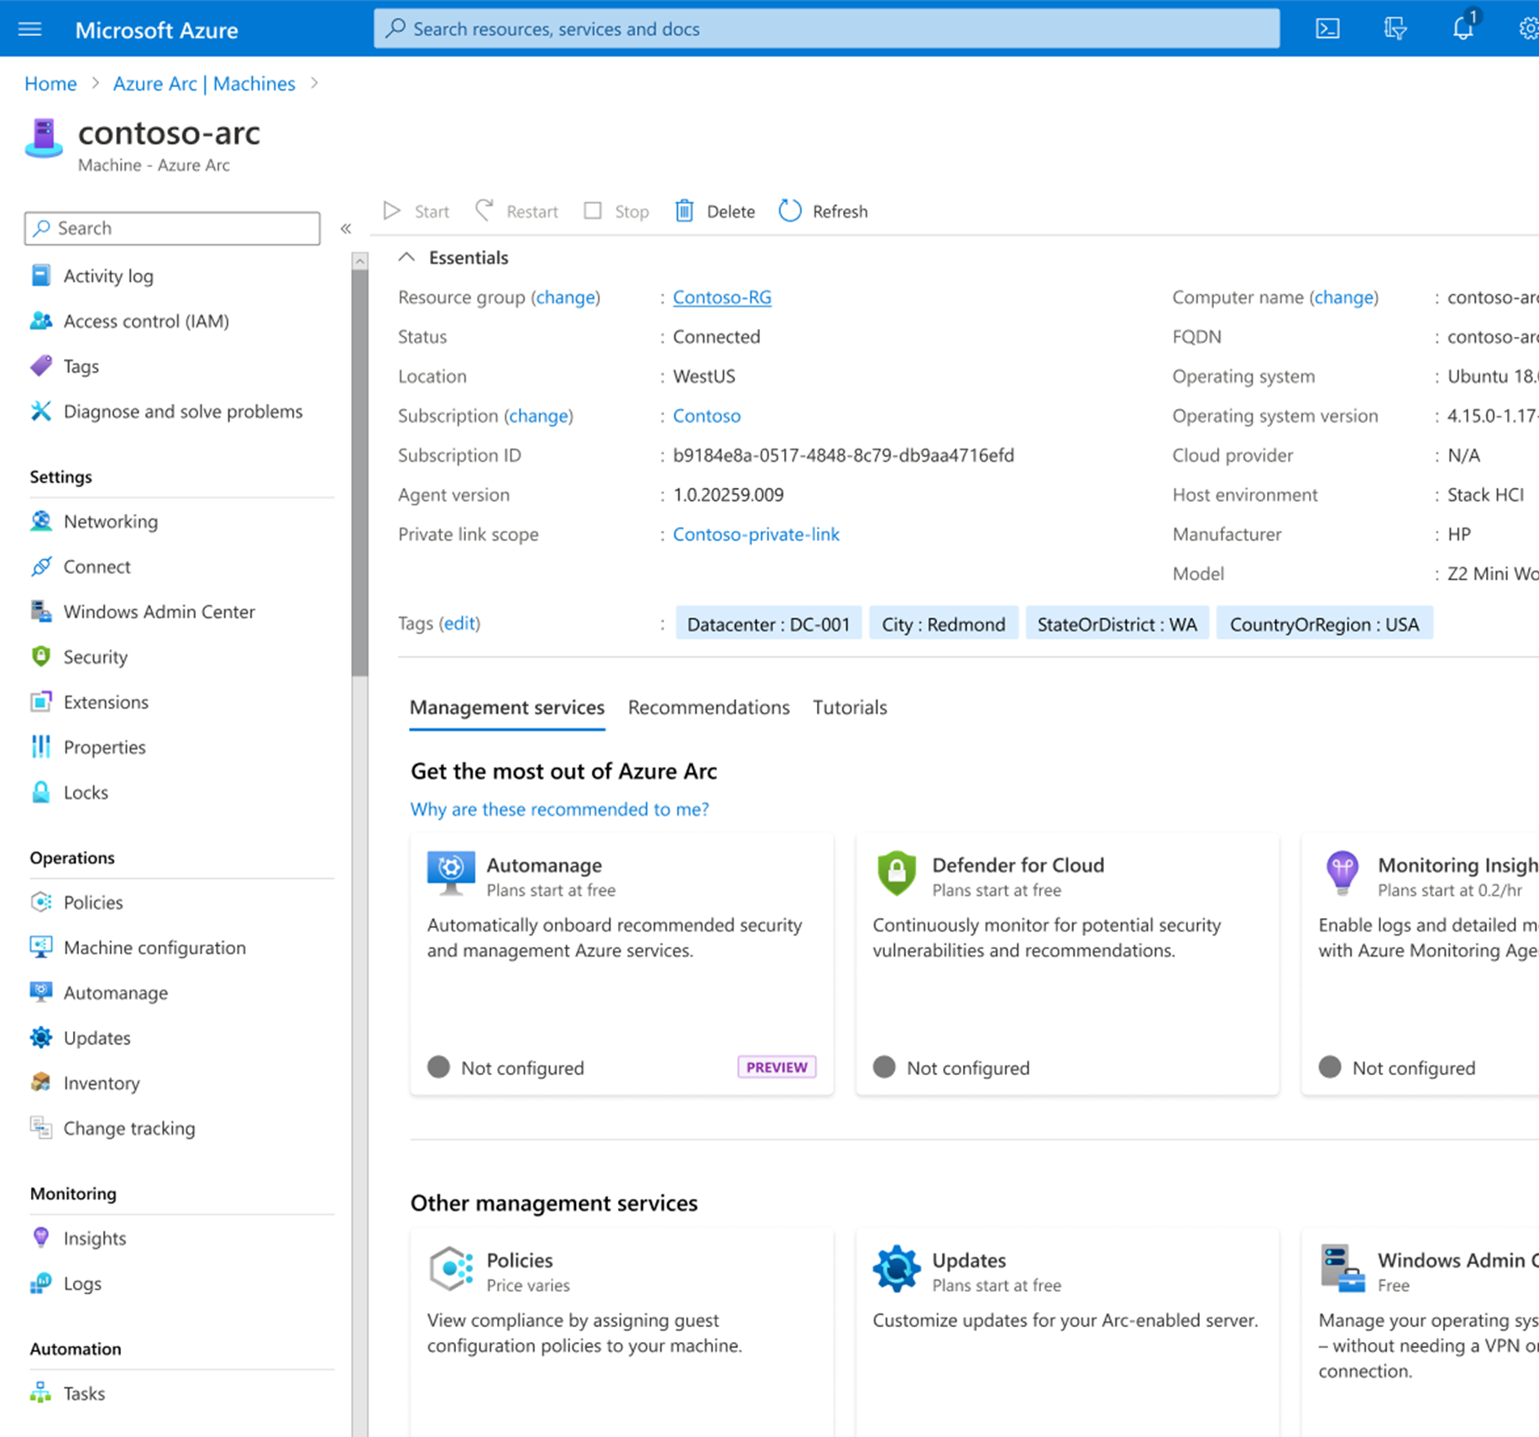
23h2 feature 3 of 7
Expanded VM Extensions support including Microsoft Defender for Cloud, Azure Monitor, and Azure Update Management

Slide 8
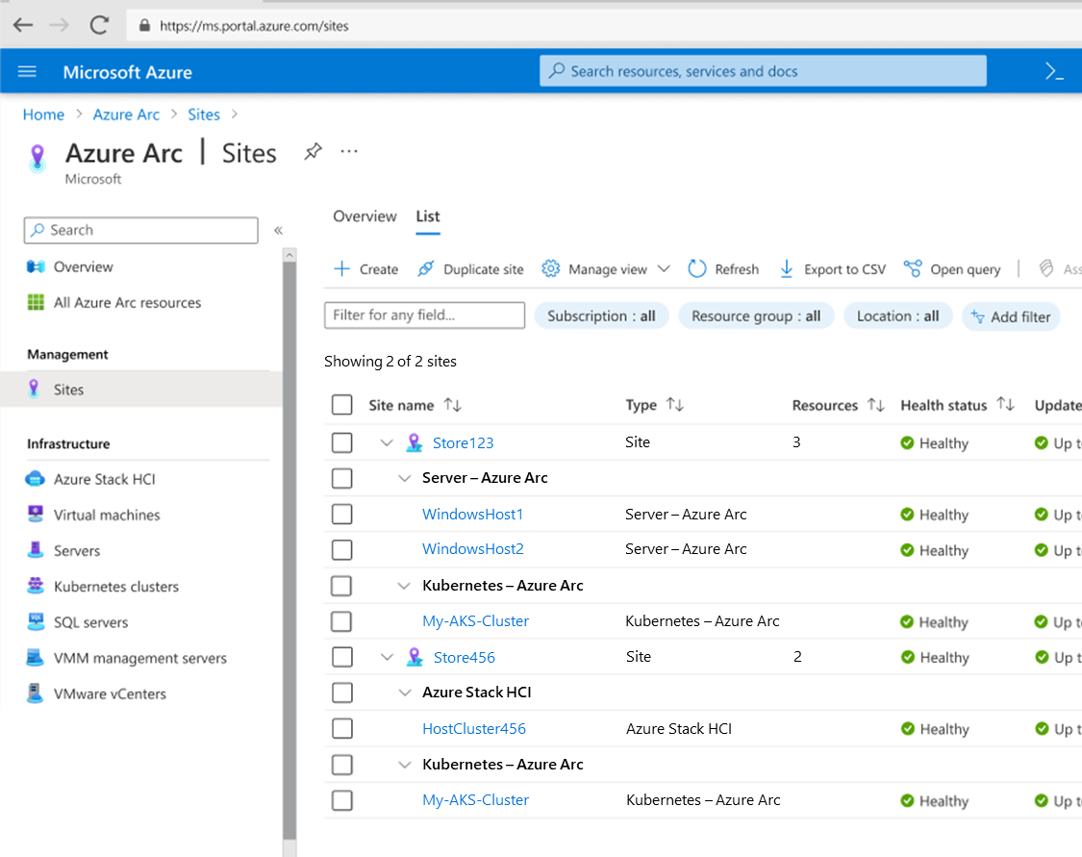
23h2 feature 4 of 7
New Site manager to help you organize resources in Azure Arc by location
Define your Sites and associate resources to them (hosts, AKS clusters, etc)
Supports new (Azure Stack HCI) and existing (Arc-enabled Windows Server) resources
* Conceptual rendering, subject to change

Slide 9
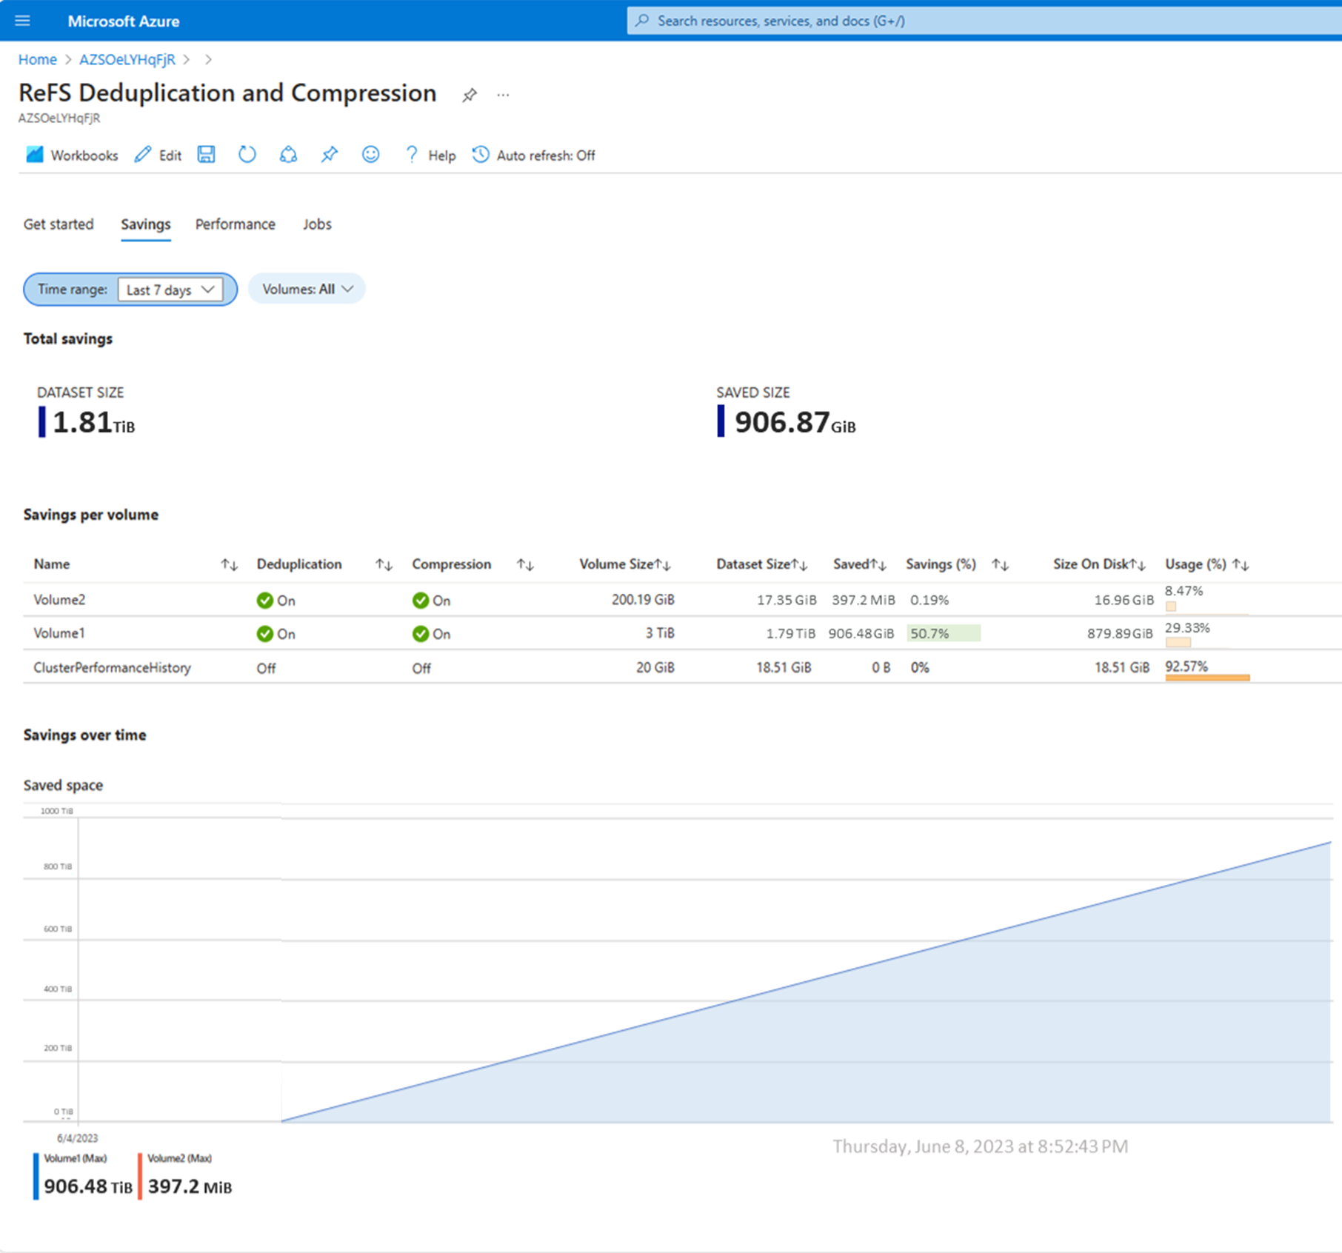
23h2 feature 5 of 7
Annual update for core stack (hypervisor, storage, etc.) with new deduplication and compression, Trusted Launch VMs, improved GPU support

Slide 10
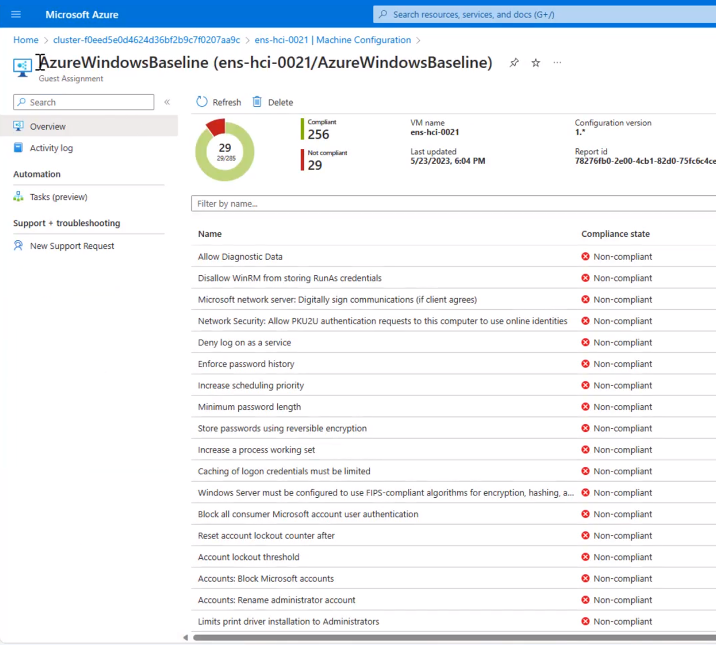
23h2 features 6 of 7
Stronger default security posture: new clusters score >90% on Azure security baseline

Slide 11
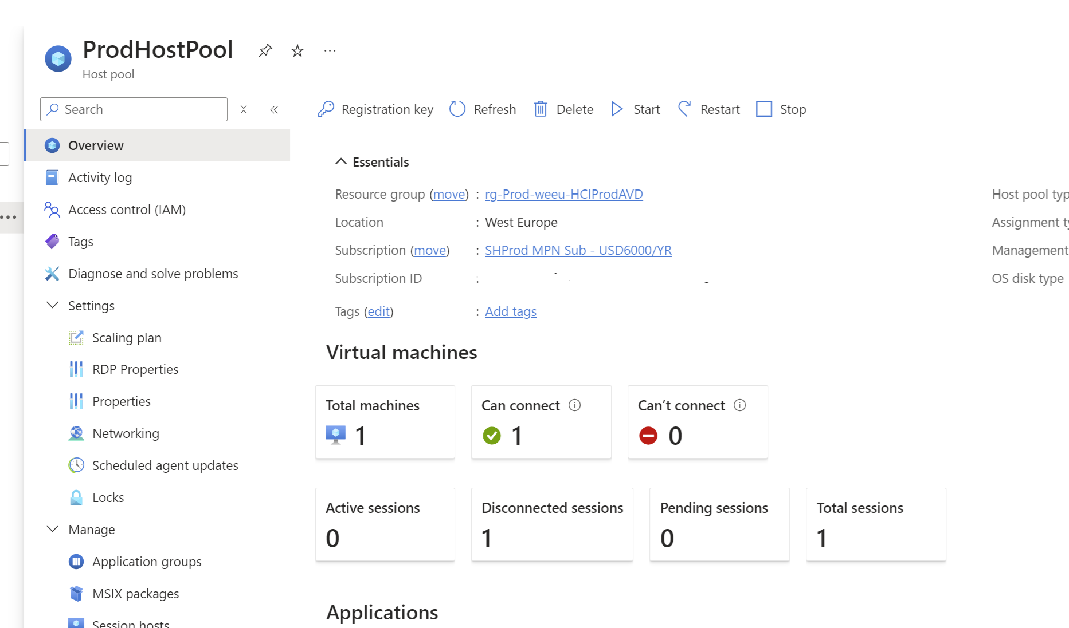
23h2 features 7 of 7
General Availability of Azure Virtual Desktop on Azure Stack HCI
Access Windows 11 and Windows 10 from anywhere
Maintain full control over configuration and management
Get the security and reliability of Azure
Optimize cost with multi-session and pay for only what you use

Slide 12
Deployment Process Tips

Slide 13
What is not supported
Upgrade from 22h2 to 23h2
Why? Comming Soon
Stretch Cluster
Why?

Slide 14
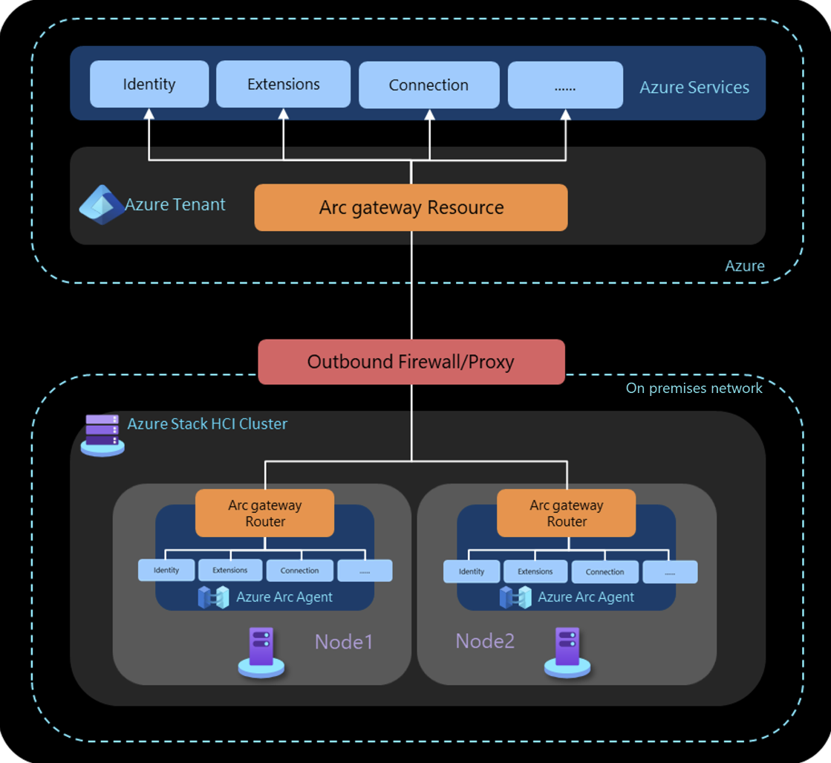
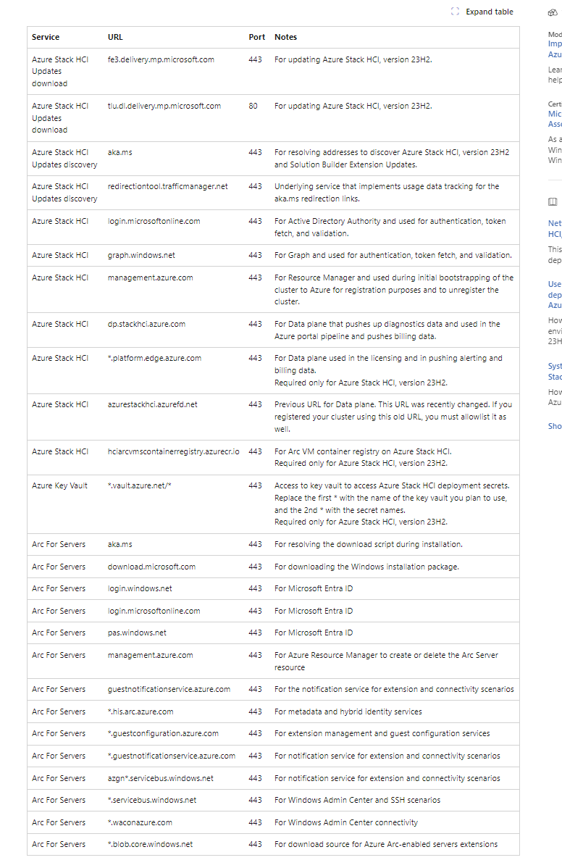
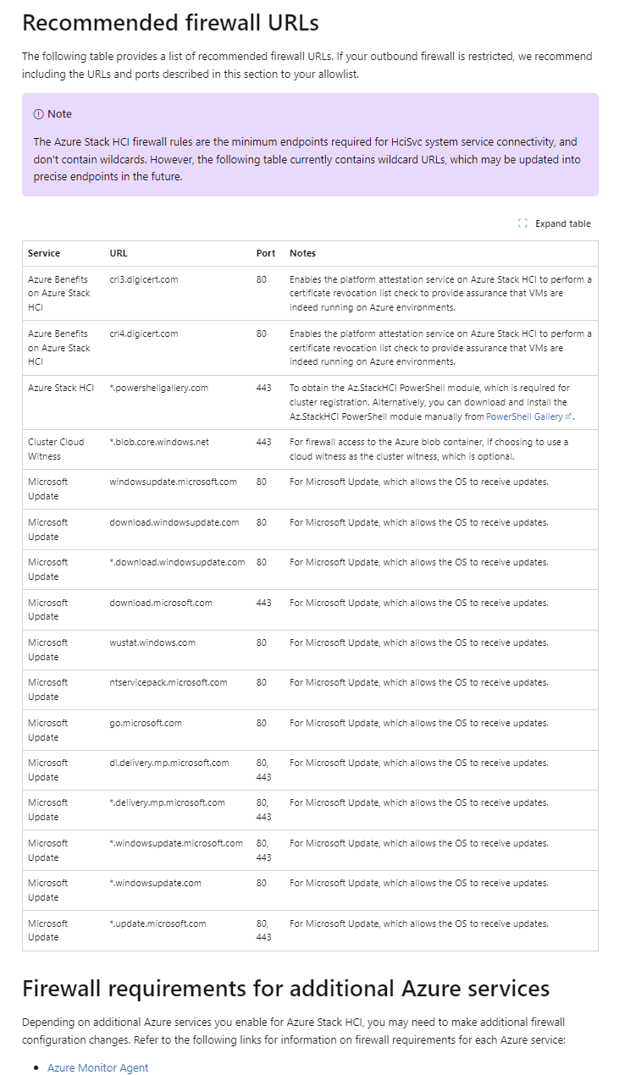
Firewall Rules
Make sure you have everything written down as the list is long
Use ARC Gateway Less URL’s to open

Slide 15
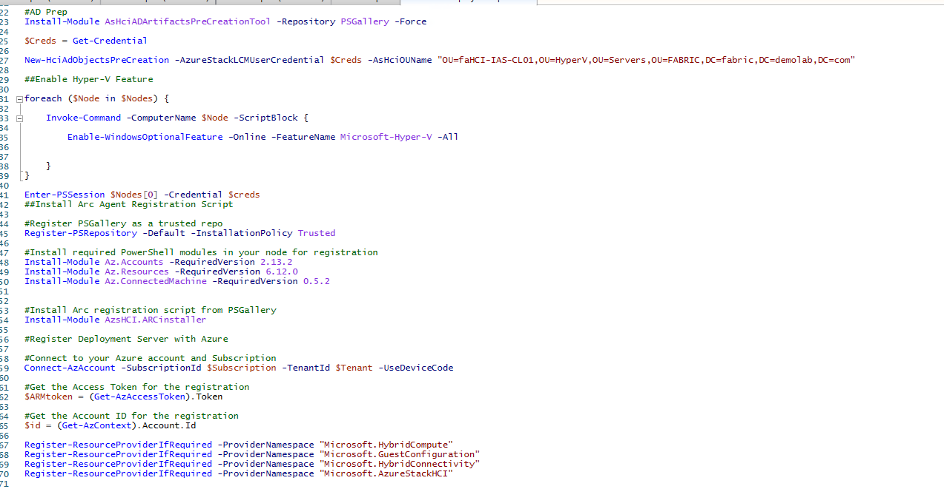
Prep HCI Nodes
Follow the guides that are available from Microsoft
Make Sure to run the AD Prep
And use scripts to build your HCI nodes
Like prepearing the orchastration node

Slide 16
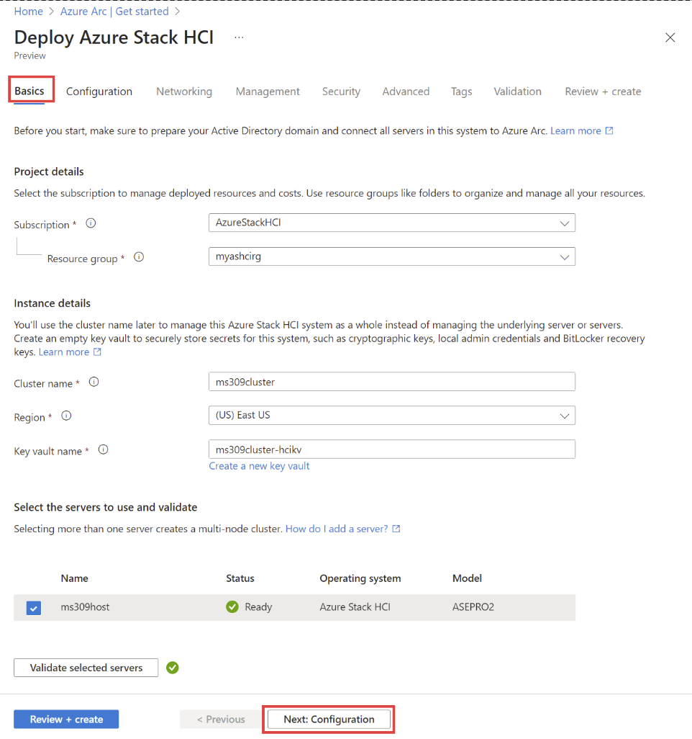
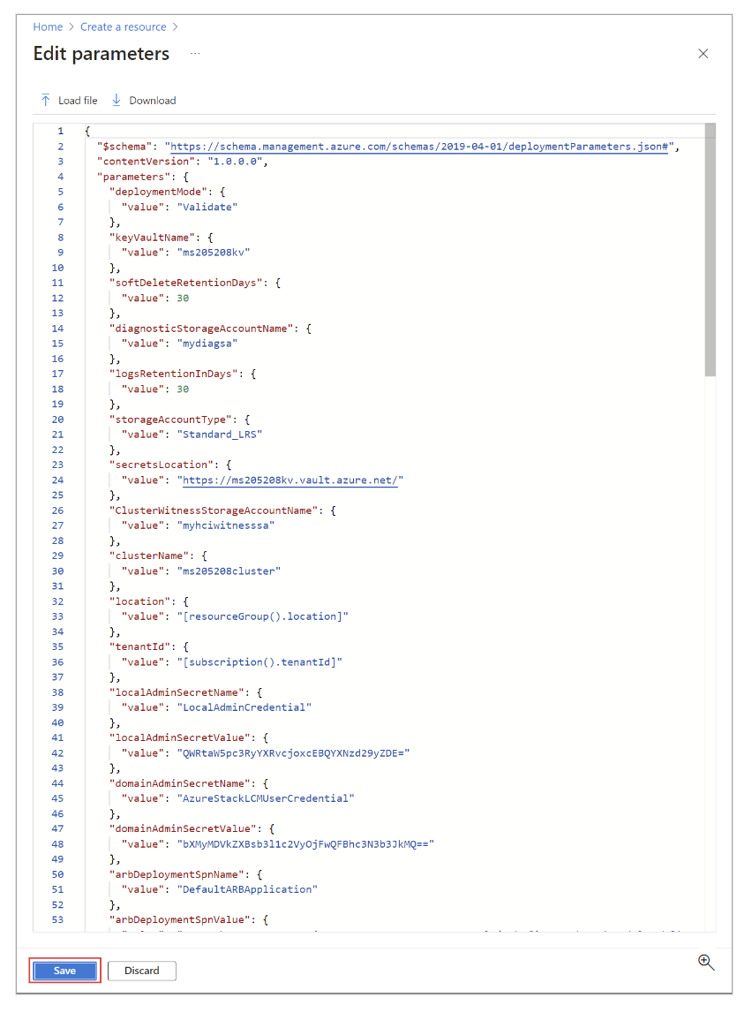
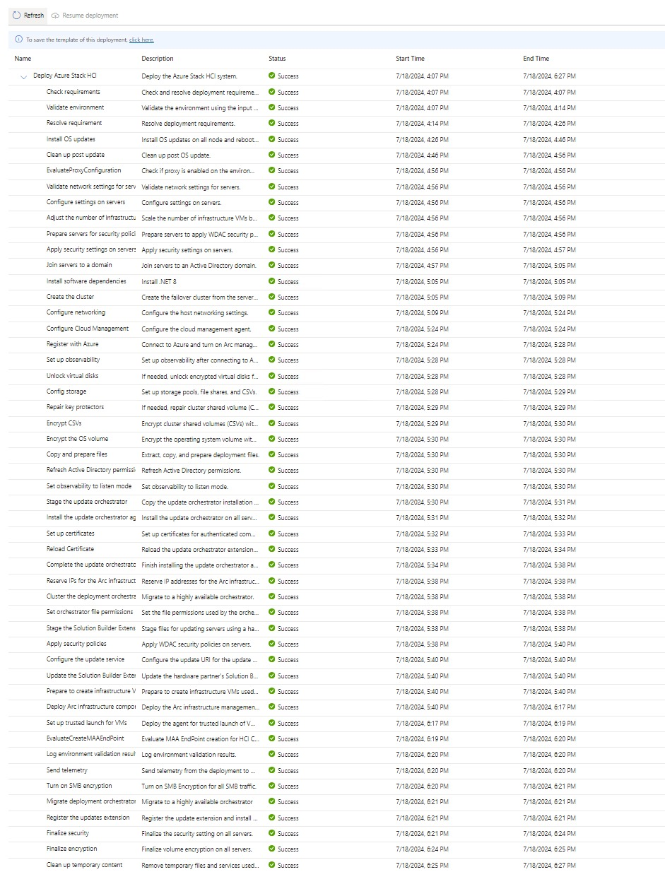
Deployment of cluster
Gui or Arm Template
Choose what you feel is best
For multi cluster deployment stick to ARM Templates

Slide 17
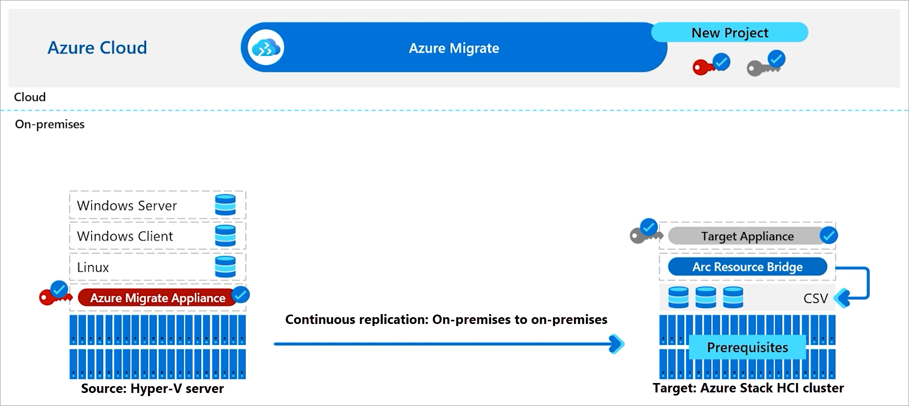
23h2 features 8 of 10
Azure Migrate from Hyper-V to Azure Stack HCI (Preview)
Provides the control plane via the Azure portal. You can use the portal to start, run, and track your migration to Azure.
Keeps the data flow local, from on-premises Hyper-V to Azure Stack HCI.
Results in a minimal downtime for the VMs running on your on-premises servers.

Slide 18
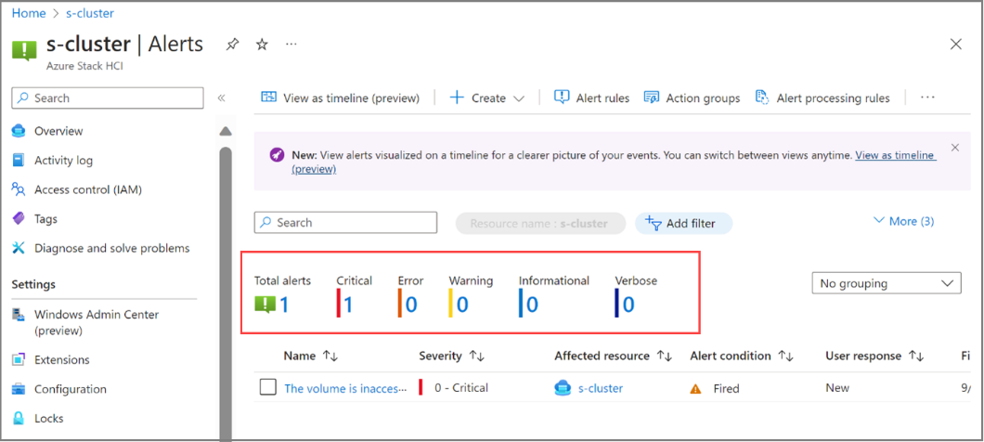
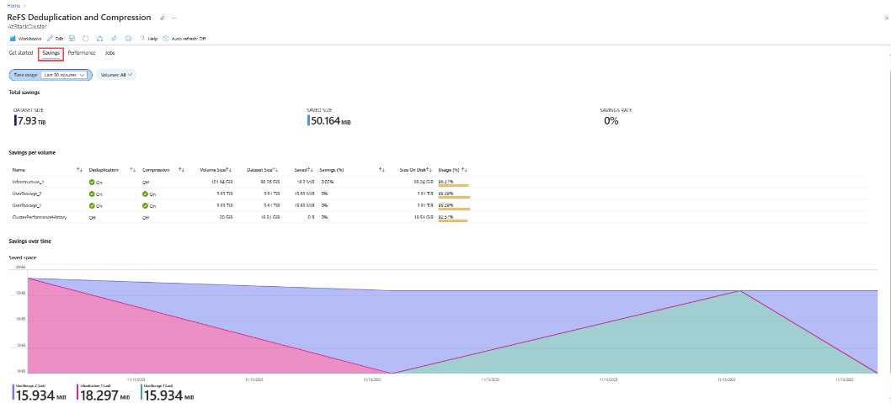
23h2 features 9 of 10
New Azure Monitor Insights, metrics and Alerts
Create Alerts based on built in health events.
More detailed metrics
Results in a minimal downtime for the VMs running on your on-premises servers.

Slide 19
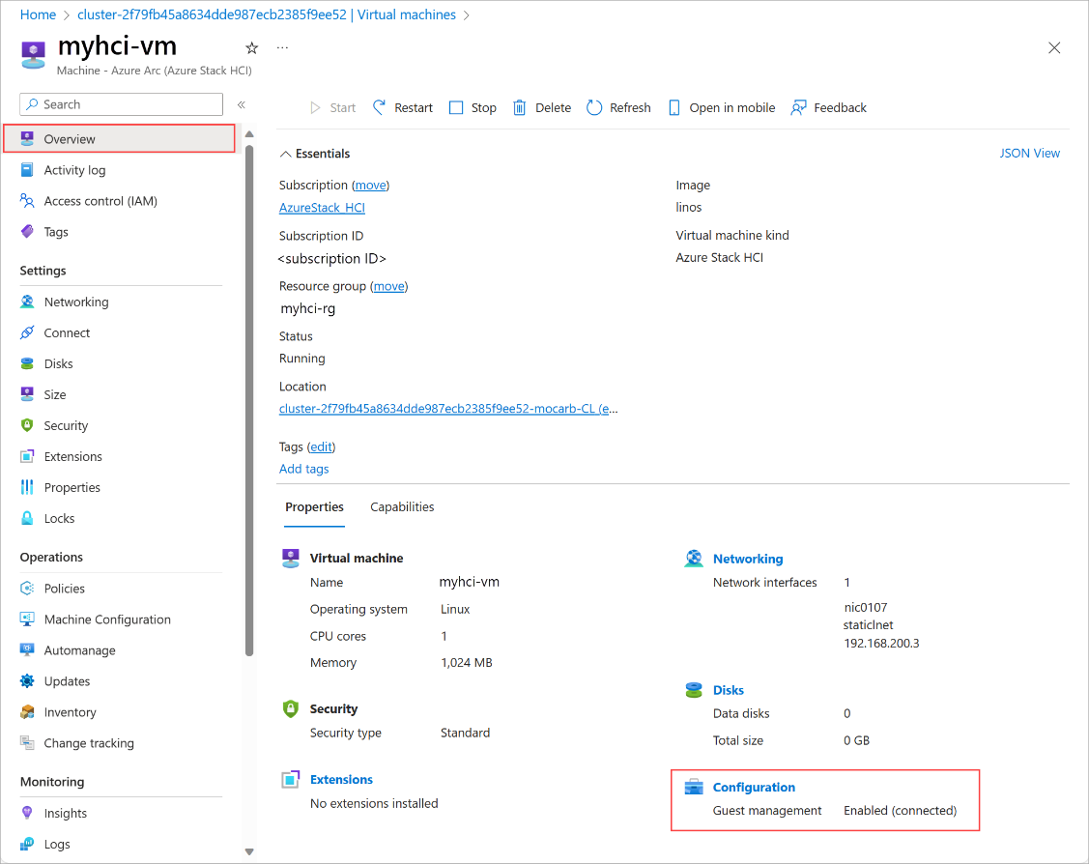
23h2 features 10 of 10
Deploy and Manage VM’s from Azure
Deploy Windows Server 2022 Azure Edition
Hydration of excisting VM’s coming soon.

Slide 20
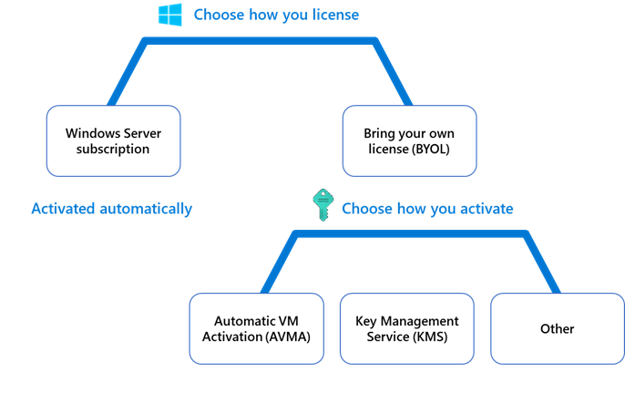
23h2 features 11 of 10
Windows Server Subscription
Bring your own license(BYOL)

Slide 21
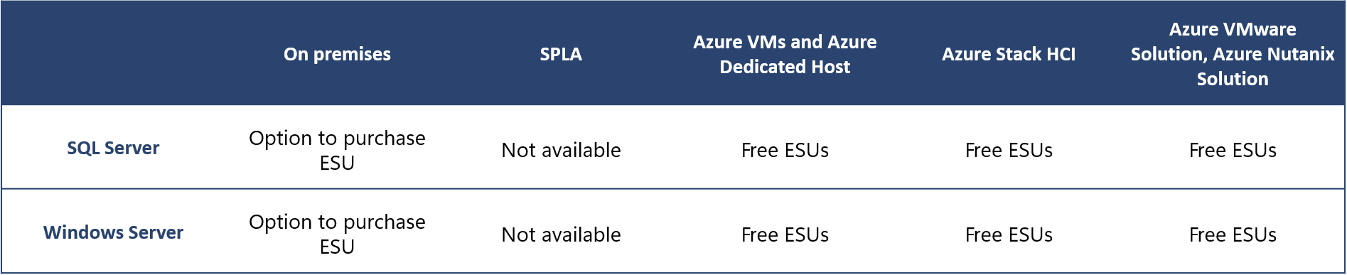
23h2 features 12 of 10
Extended Security Updates(ESU) free with Azure Stack HCI
2012 and 2012R2 up until October 10th 2026

Slide 22

Software defined networking (SDN) for Arc VMs – Public Preview
Use Arc control plane to:
Create logical networks (LNET) and network interfaces (NIC) backed by network controller
Hydrate existing logical networks on a HCI cluster to be managed by network controller
Create Network security groups(NSG) and assign inbound/outbound security rules to your NSG
Configure NSG when creating LNETs and NICs to secure east-west network traffic between logical networks/virtual machines.
Assign NSGs to existing LNETS and NICs and update NSGs on LNETs and NICs.
Targeted for Nov 2024

Slide 23
Azure Stack HCI SDN and Arc integration Roadmap
Milestone 1
Milestone 2
Milestone 3
Milestone 4
2408 Release
Private Preview
Public Preview
GA
GA
Network Controller as Failover Cluster Service and Managed by LCM
MOC Integration
SDN LNETs
SDN Network Interface
SDN NSGs Portal and CLI Mgmt.
Only 1 Compute vSwitch SDN Support
Network Controller as Failover Cluster Service and Managed by LCM
MOC Integration
SDN LNETs
SDN Network Interface
SDN NSGs Portal and CLI Mgmt.
Only 1 Compute vSwitch SDN Support
Network Controller as Failover Cluster Service and Managed by LCM
MOC Integration
SDN LNETs
SDN Network Interface
SDN NSGs Portal Mgmt.
Only 1 Compute vSwitch SDN Support
Network Controller as Failover Cluster Service and Managed by LCM
MOC Integration
SDN LNETs
SDN Network Interface
SDN NSGs Portal Mgmt.
Multiple Compute vSwitch SDN Support
Private Preview
Public Preview
Virtual Networks
SDN Load Balancers
Multiple Compute vSwitches SDN support
Virtual Networks
SDN Load Balancers
Private Preview
SDN Gateways

Slide 24
Questions?

Slide 25
Session Survey
Your feedback is very important to us
Please take a moment to complete the session survey found in the mobile app
Use the QR code or search for “Converge360 Events” in your app store
Find this session on the Agenda tab
Click “Session Evaluation”
Thank you!

Slide 26
Thank You github.com/jantorep/techmentor

